Slide 1
Jelly Roll Smelt Shattering
Weekly Meeting
Taoxin Jiang

Slide 2
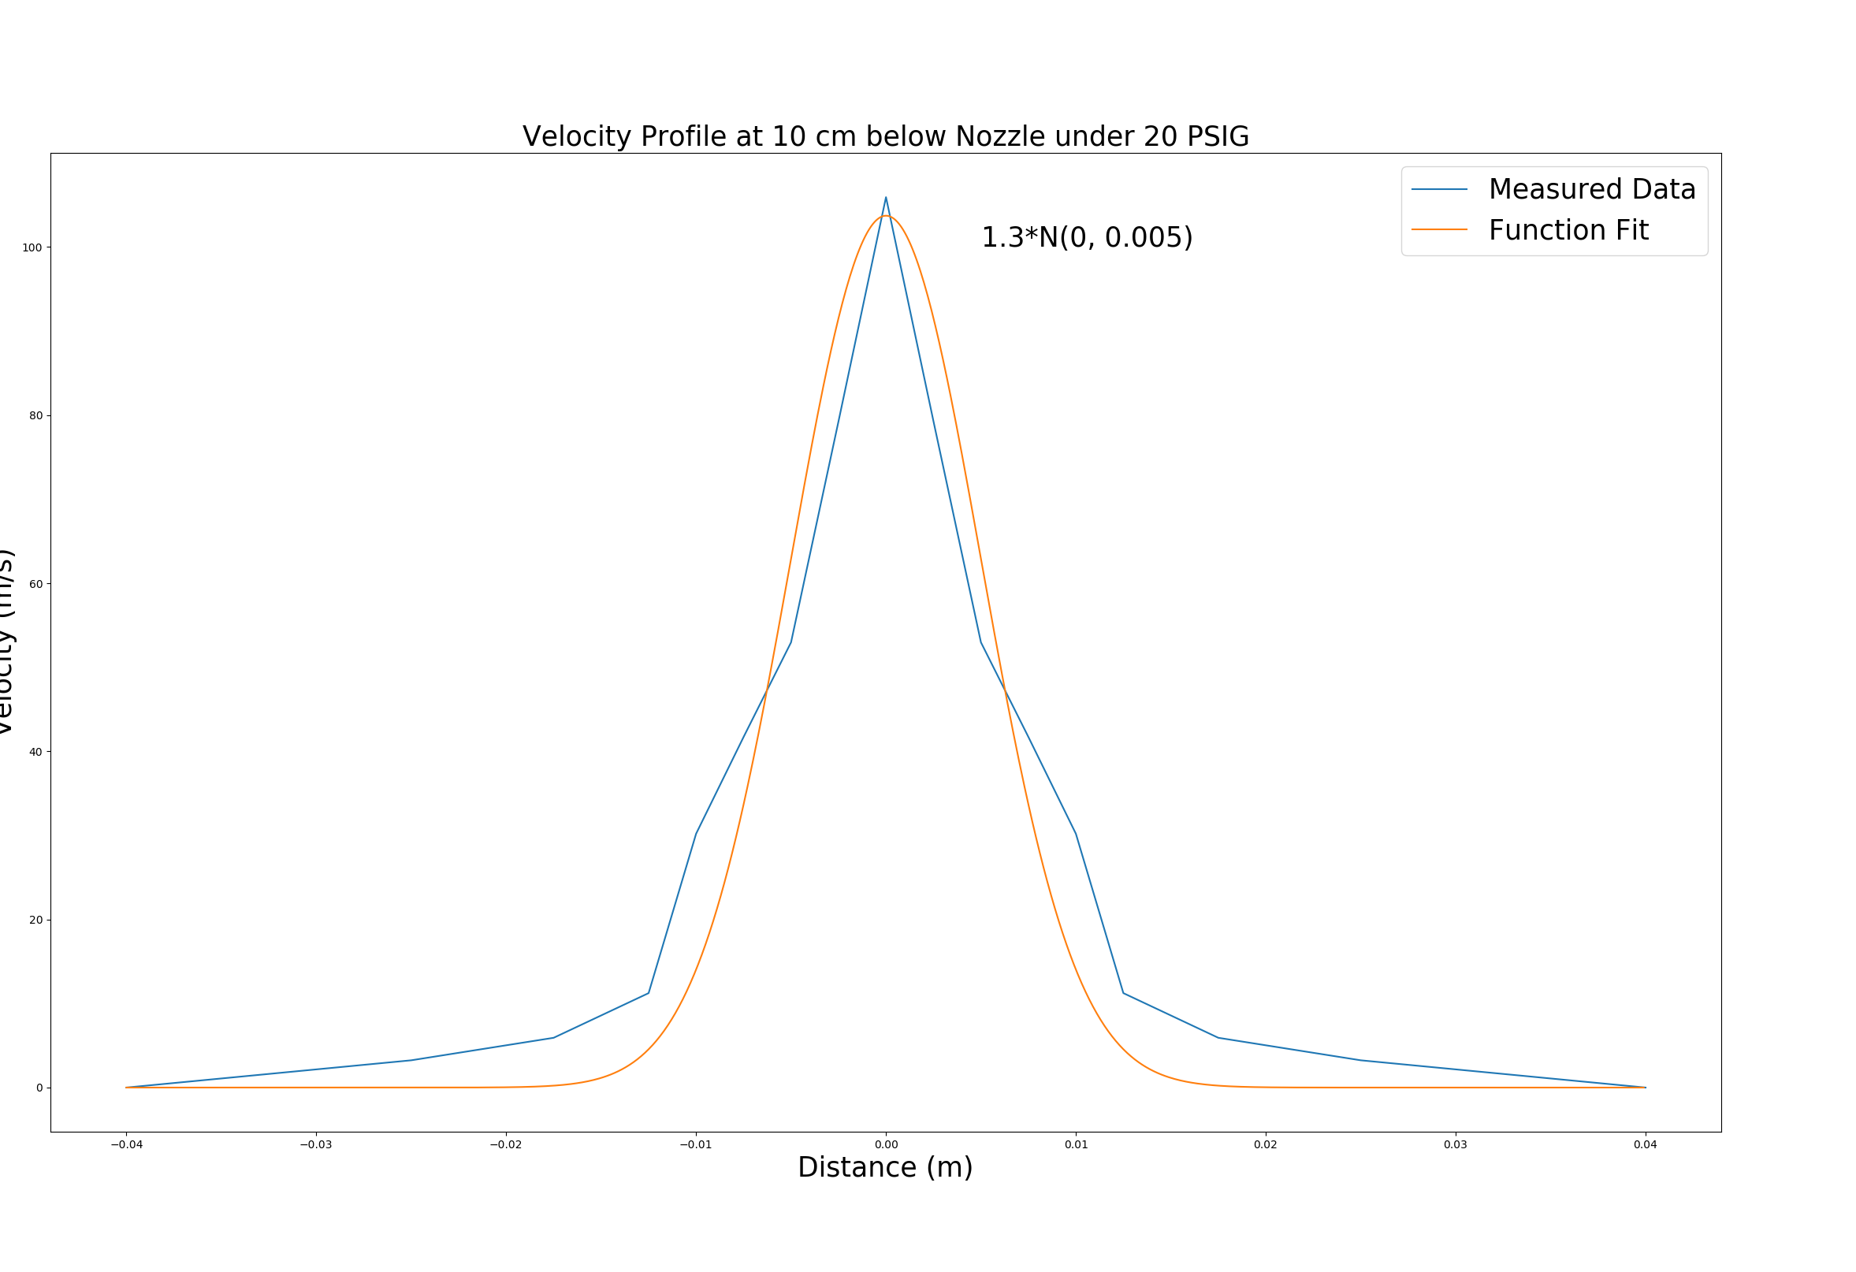
Velocity Profile 20 PSIG
Centre Line Velocity: 105 m/s
Flow Rate: 0.0163 m^3/s

Slide 3
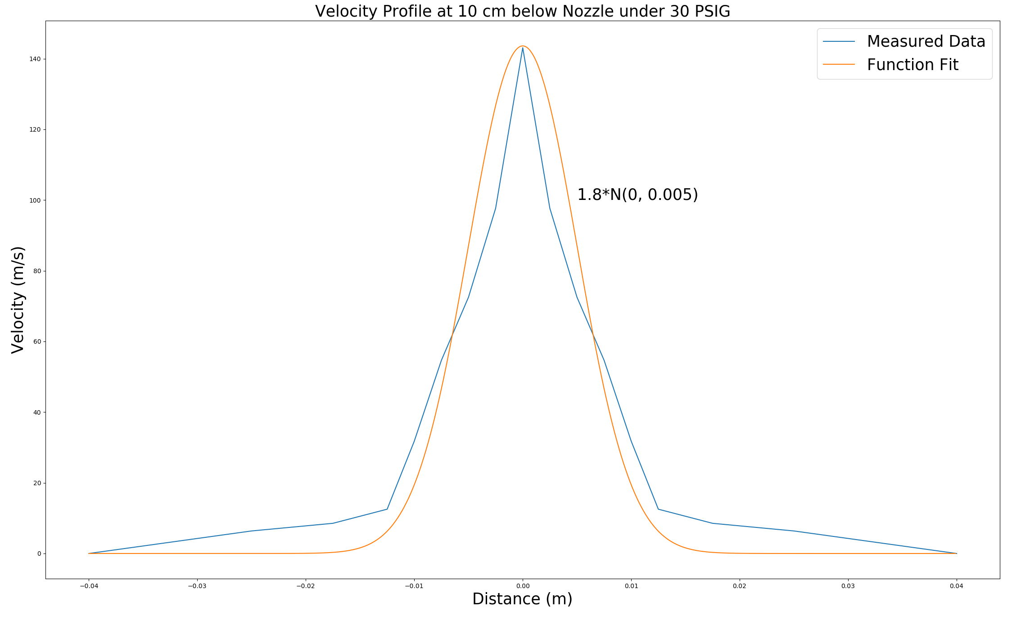
Velocity Profile 30 PSIG
Centre Line Velocity: 143 m/s
Flow Rate: 0.0225 m^3/s

Slide 4
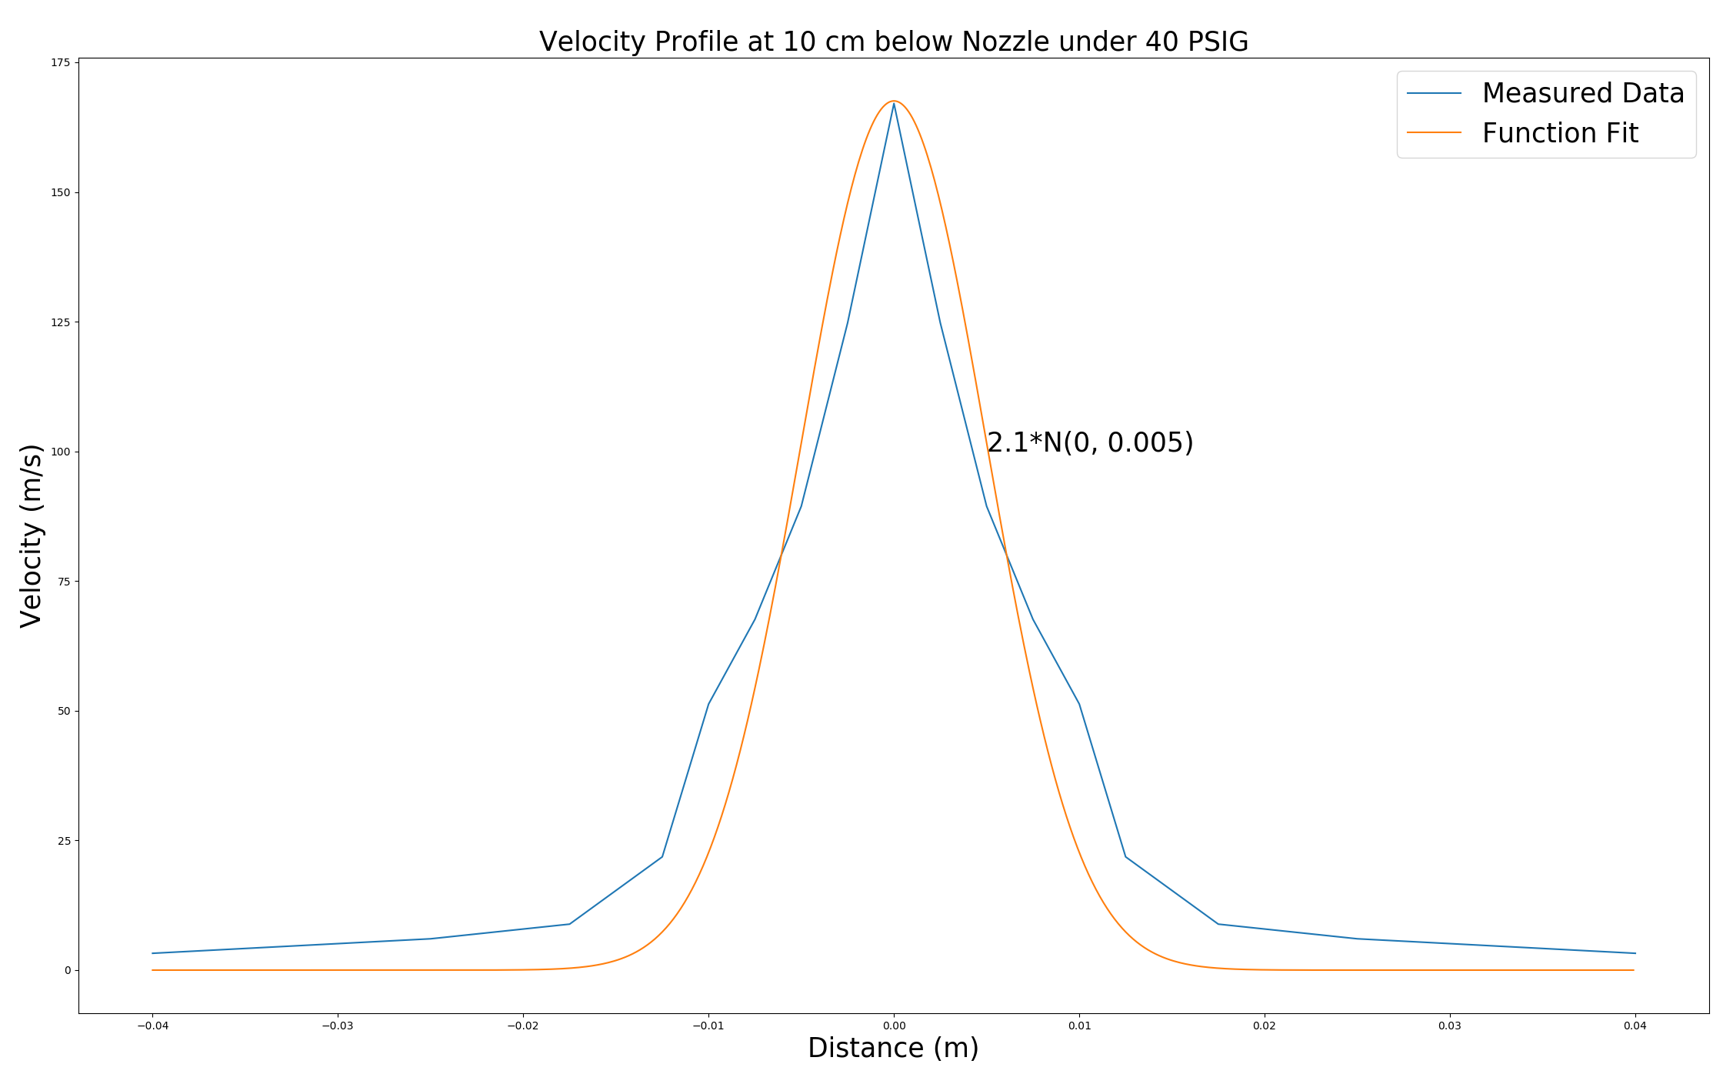
Velocity Profile 40 PSIG
Centre Line Velocity: 167 m/s
Flow Rate: 0.0263 m^3/s

Slide 5
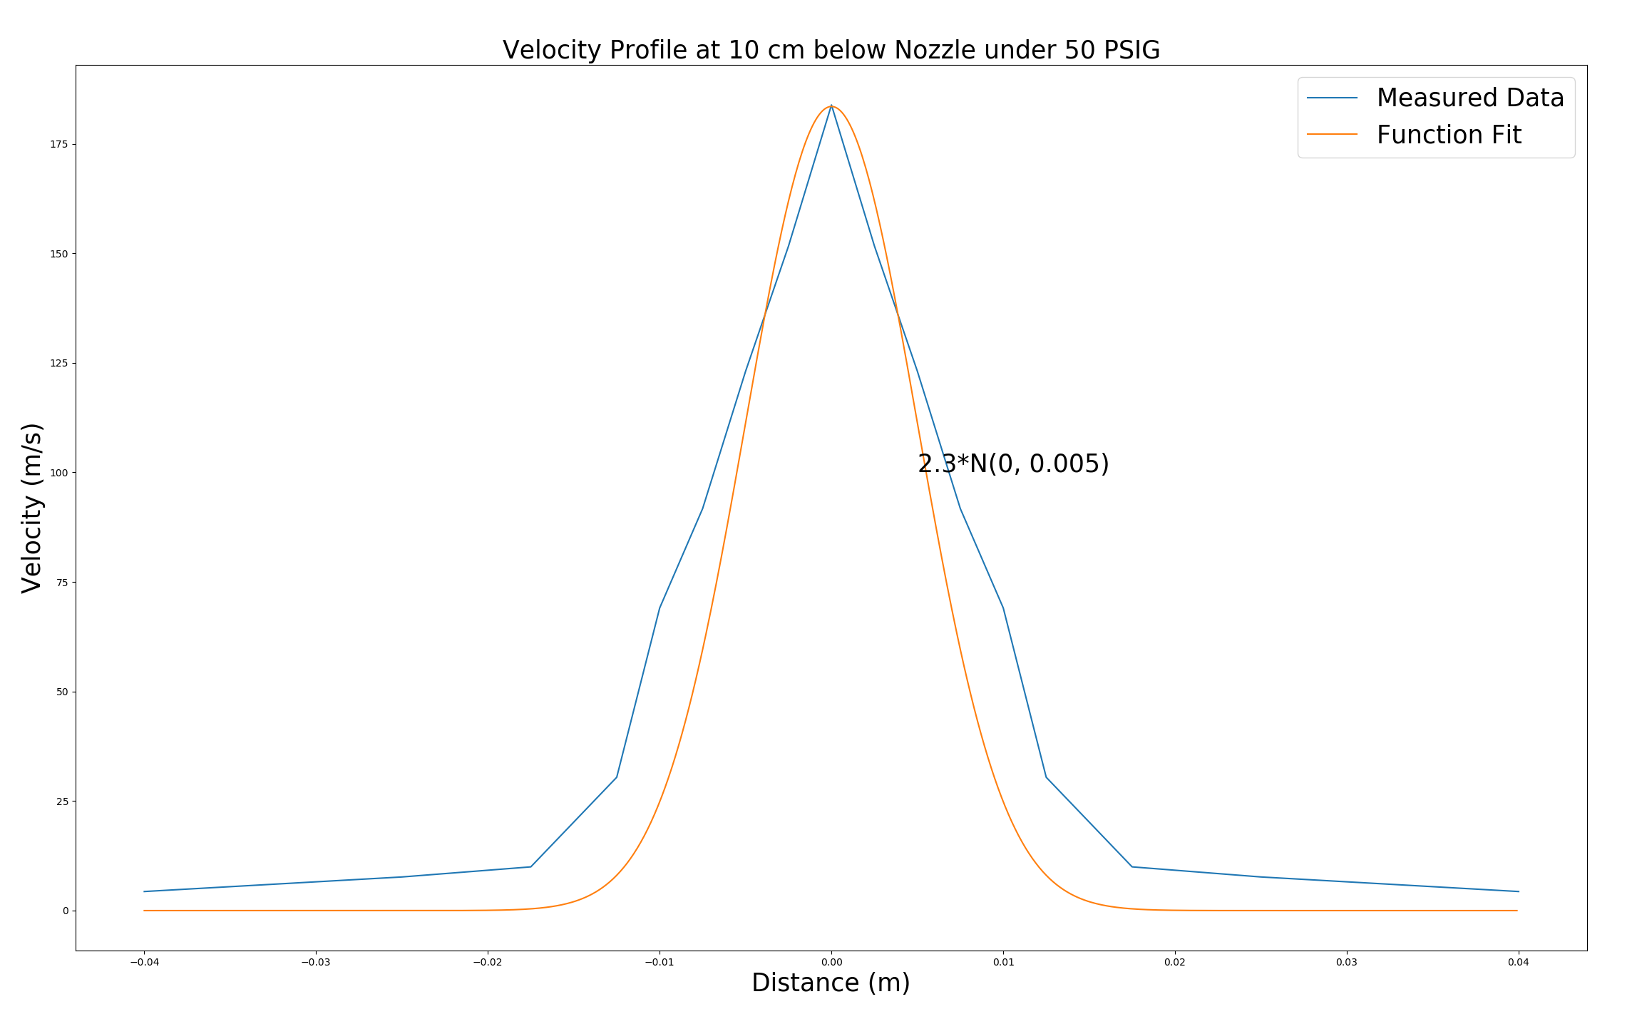
Velocity Profile 50 PSIG
Centre Line Velocity: 183 m/s
Flow Rate: 0.0288 m^3/s

Slide 6
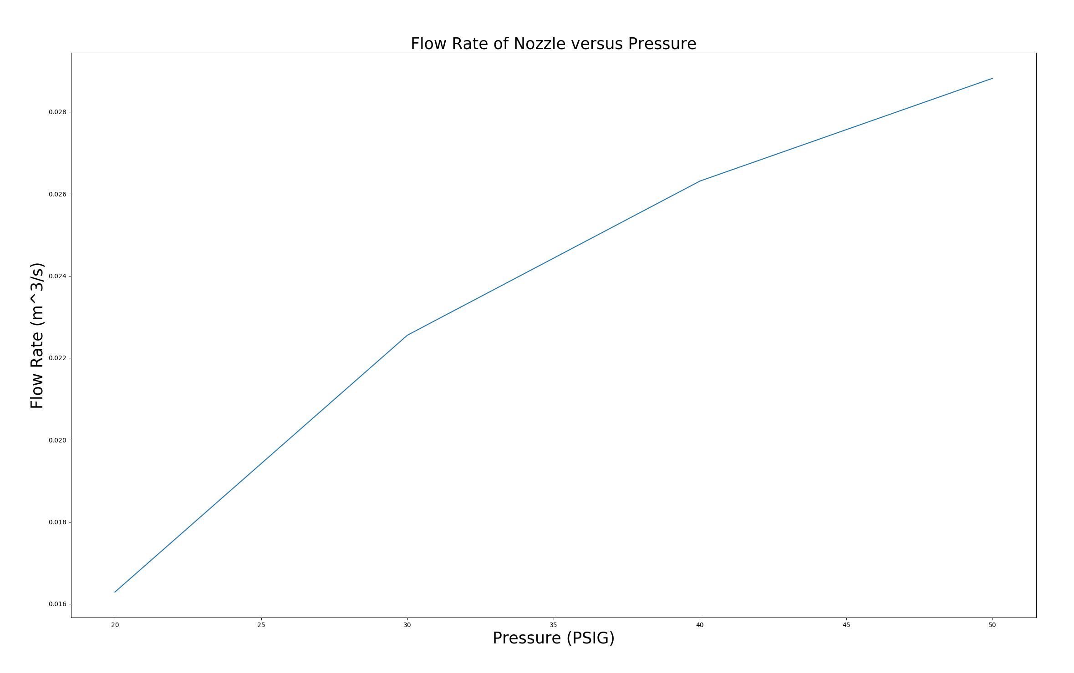
Pressure Versus Flow Rate

